Slide 1
TEST PART 3: PLEASE WRITE DOWN THE QUESTIONS THAT APPEAR ON THE FOLLOWING SLIDES.
AS A CLASS YOU WILL BE ASKED TO TRY AND ANSWER THE QUESTION VERBALLY.
FOLLOWING THIS I WILL SHOW YOU THE ANSWER AND DISCUSS IT WITH YOU.
DUE TO THE UNFAIR SITUATION THAT MY ABSENCE HAS PUT YOU IN, CONSIDERING THE EXTREME DIFFICULTY OF SOME OF THE MATERIAL THAT I WANTED TO COVER, I AM GOING TO CONSIDER YOUR ABILITY TO COPY DOWN THE NOTES I PLAN ON GIVING YOU AS A TEST.
SINCE YOU HAVE NOT HAD ANY EXAM ON THIS MATERIAL, THIS WILL BE WORTH QUITE A FEW POINTS ON YOUR GRADE. IT VERY WELL MAY MEAN THE DIFFERENCE OF PASSING OR FAILING THIS CLASS.
IF YOUR ANSWERS ONLY INCLUDE THE POWERPOINT NOTES THAT I GIVE YOU, YOU WILL RECEIVE A GRADE OF “B+”
IF YOU INCLUDE IN ALL OF YOUR ANSWERS ANY EXTRA INFORMATION FROM YOUR NOTES OR FROM THE INFORMATION THAT I IMPART VERBALLY THAT IS NOT SPECIFICALLY MENTIONED ON THE POWERPOINT YOU WILL RECEIVE A GRADE OF “A”
IF AT ANY TIME, I SEE SOMEONE USING THEIR CELLPHONE IN NY WAY. YOUR GRADE WILL BEEN AN “F”.

Slide 2
1. What is Utilitarianism?
Utilitarianism:
The moral philosophy that actions derive their moral quality from their usefulness as means to some end, especially as means productive of happiness or unhappiness.
Applied to civics and politics, the greatest happiness of the greatest number should be the sole end and criterion of all public action.

Slide 3
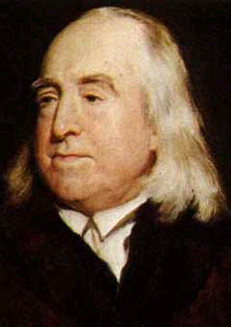
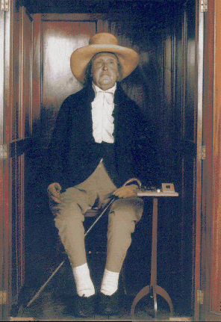
Utilitarianism
2. Who was Jeremy Bentham and what kind of Utilitarianism did he espouse?

Slide 4
Jeremy Bentham’s Utilitarianism
Recognized as ‘Act Utilitarian’
Right actions result in ‘good or pleasure,’ wrong actions result in pain or absence of pleasure.
“Hedonic Calculus:” measuring pleasure and pain using what amounts to a formula
(it measures certain qualities intensity, duration etc…). This calculation allows a utility based decision to be made on virtually any subject.
Notes:
Jeremy Bentham (1748-1832), an English philosopher or utilitarian, was born in Houndsditch, London. Entered Queens College, Oxford, at twelve and graduating at fifteen. He studied law at Lincoln’s Inn and was admitted to the bar at nineteen
Credited as being the founder of Utilitarianism
According to Bentham, the good is to be identified with pleasure (or the absence of pain).
So, for him, right actions are those actions that maximize pleasure.
Utilitarianism came in for a good deal of criticism - it was called a “doctrine worthy of swine”.
John Stuart Mill (a 19th century British philosopher) developed amore sophisticated version of the theory. Mill agrees that right actions are those actions that promote the greatest good for the greatest number. However, Mill argues that we should be as concerned with the quality of pleasure we produce as with the quantity we produce, where pleasures that result from the exercise of uniquely human capacities are said to be superior to the that result from the capacities we have in commn with other animals. Thus Mill’s version of utilitarianism is sometimes characterized in terms of our obligation to maximize happiness rather than pleasure.

Slide 5
Utilitarianism
John Stuart Mill’s Utilitarianism
Concerned with quality of pleasure and quantity of people who enjoy it.
Recognized higher and lower types of human pleasure.

Slide 6
Utilitarianism
John Stuart Mill’s Utilitarianism
Lower pleasures: eating, drinking, sexuality, etc.
Higher pleasures: intellectuality, creativity and spirituality.
‘Better to be Socrates dissatisfied than a fool satisfied’

Slide 7
Utilitarianism
Act (Contemporary) Utilitarianism
“An act is right if and only if it results in as much good as any available alternative.”

Slide 8
Utilitarianism
Rule Utilitarianism
“An act is right if and only if it is required by a rule that is itself a member of a set of rules whose acceptance would lead to greater utility for society than any available alternative.”

Slide 9
Rule Utilitarianism
Debated as a valid form of Utilitarianism
Exceptions to the rules can often be found!
Three levels of rules suggested: Rules of thumb always to be followed unless in conflict with another rule.
Higher level rules which override thumb rules.
No rules apply – do your best!

Slide 10
Utilitarianism
Rule Utilitarianism: Levels of Rules
Rules of thumb always to be followed unless in conflict with another rule.
Higher level rules which override thumb rules.
No rules apply – do your best!

Slide 11
Utilitarianism “Society and the Bomb”
Read the Hand Out about the decision to drop the atomic bomb of Japan.
Using only the tenets of the Utilitarian Philosophy give your opinions as to whether or not America should have done this or not.
Your essay should be AT LEAST 5 paragraphs long. You will be given time to work on your essay in class, but you should not limit yourself to this time.
Notes:
“...they must be administered a tremendous shock which would carry convincing proof of our power to destroy the Empire.”
“The decision to use the atomic bomb was a decision that brought death to over a hundred thousand Japanese… But this deliberate, premeditated destruction was our least abhorrent choice.?

Slide 12
Utilitarianism “Society and the Bomb”
Is killing the innocent always wrong, no matter what the consequences?
Would you have advised President Truman to drop the bomb?
Notes:
“...they must be administered a tremendous shock which would carry convincing proof of our power to destroy the Empire.”
“The decision to use the atomic bomb was a decision that brought death to over a hundred thousand Japanese… But this deliberate, premeditated destruction was our least abhorrent choice.?

